Slide 1
Excited States of Donor-Acceptor Materials
Nikolas Vitaliti s223455

Slide 2
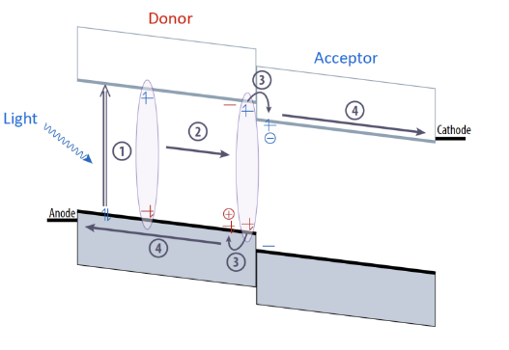
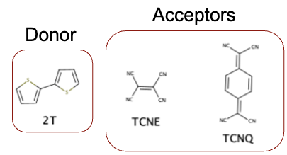
Introduction
AMS:
investigate D-A materials by setting up the software using different parameters
geometry optimization, excitation and relaxation
Donor-acceptor molecules:
Modification of the molecular core and by attaching subsituents, change e⁻ density
Organic solar cells
D-A materials: lightweight, low cost and tunable
Investigate the best molecule for OSC application

Slide 3
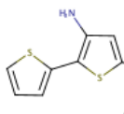

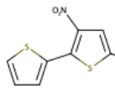

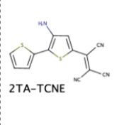
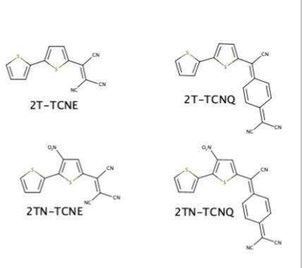
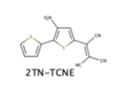

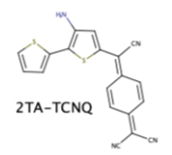
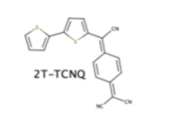
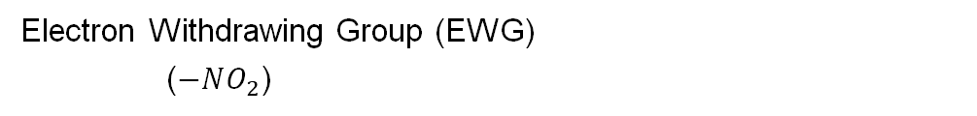
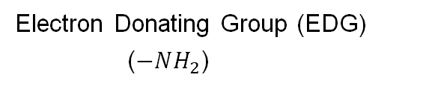
Electron Donating Group (EDG)
($−NH_{2}$)
DONOR
+ substituents
Electron Withdrawing Group (EWG)
($−NO_{2}$)
ACCEPTOR-1
ACCEPTOR-2

Slide 4
Methodology
TASK 1:
(1) Ground state geometry optimization
TASK 2:
(2.1) Electronic structure of the ground state
(2.2) S0 – S1 excitation, absorption
TASK 3:
(3.1) Excited state geometry optimization (S1 ≈ T1 assumption)
(3.2) Electronic structure of the excited state
(3.3) T1 – S0 emission

Slide 5
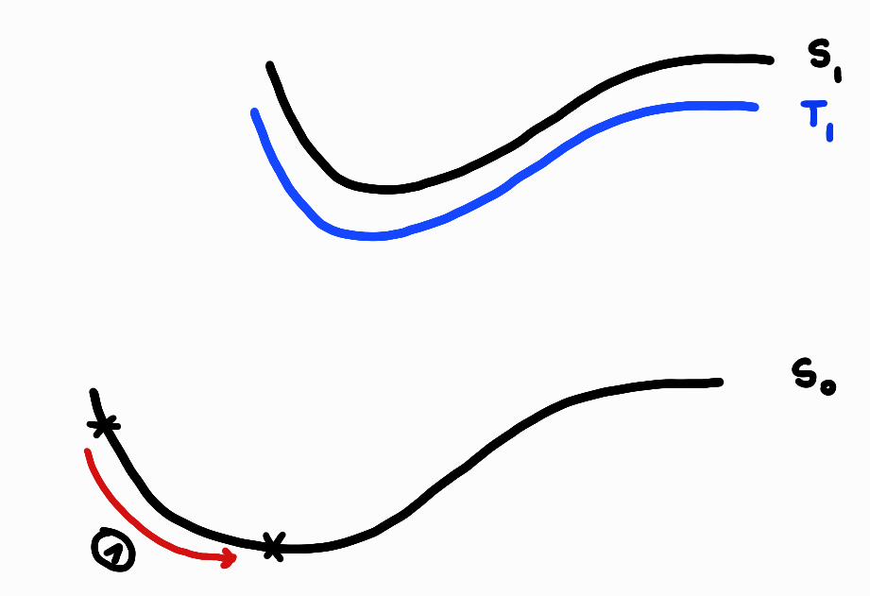
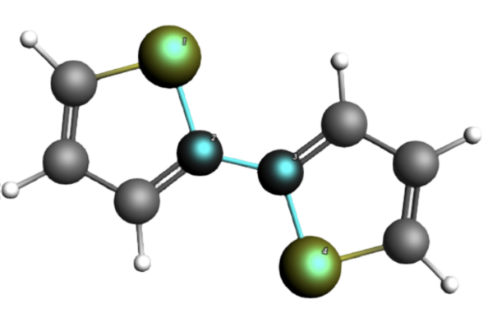
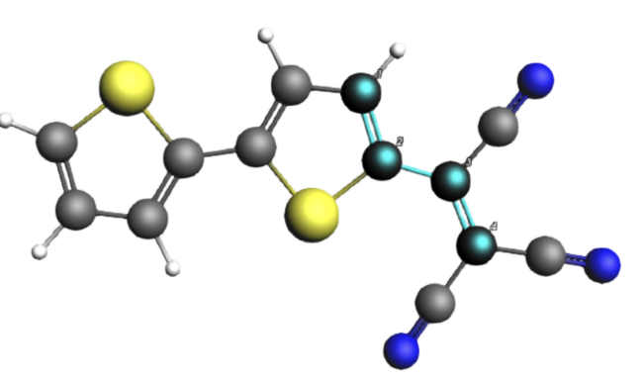
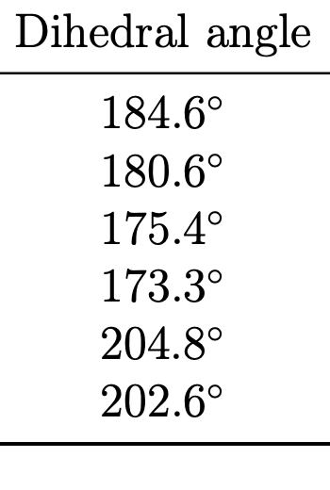
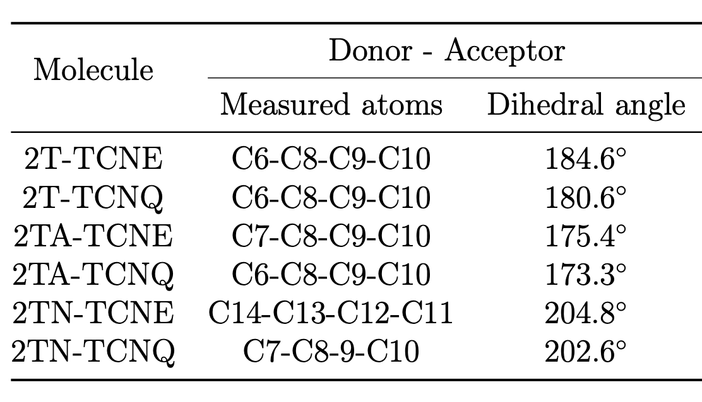
Task1
Task 2
Task 3
Ground-state geometry optimization
1
Dihedral angle in donor
Dihedral angle between donor-acceptor
Change with substituents
Increase with –NH₂ (≈ 200°)
Decrease with –NO₂ (≈ 175°)
Decrease with -NH₂
Increase with -NO₂

Slide 6
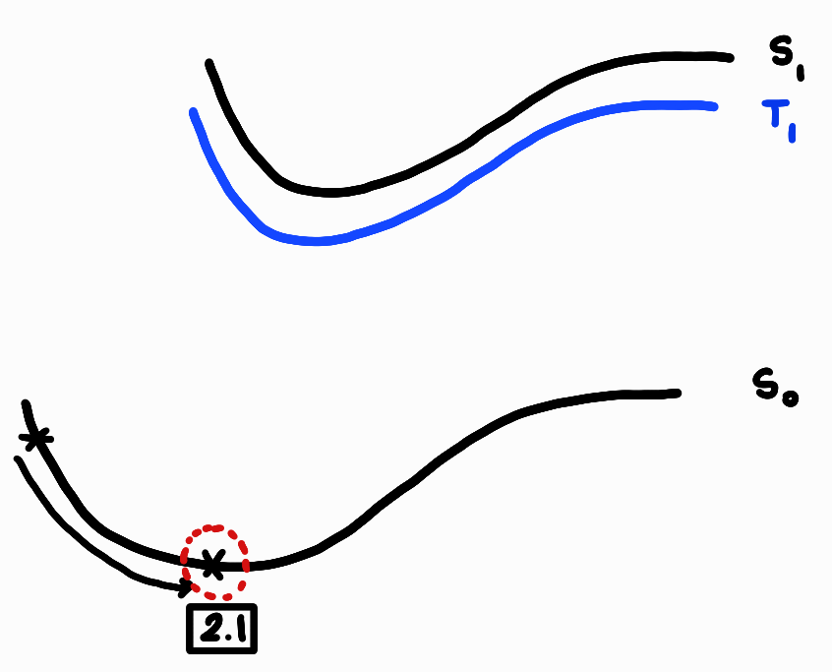
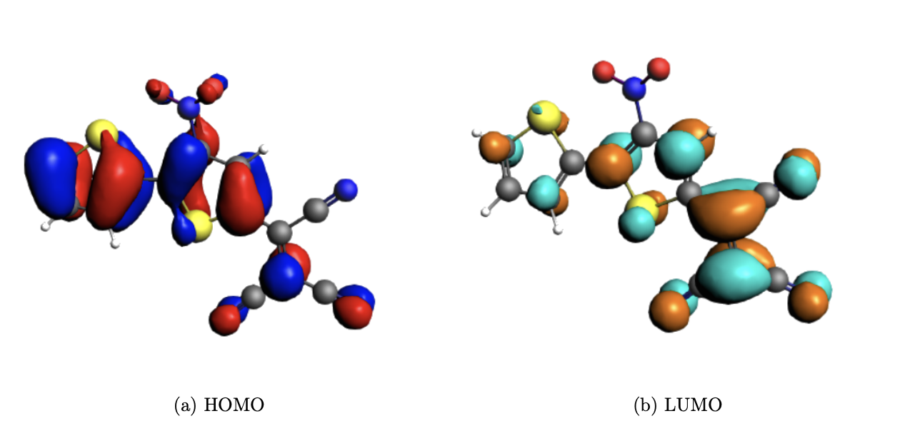
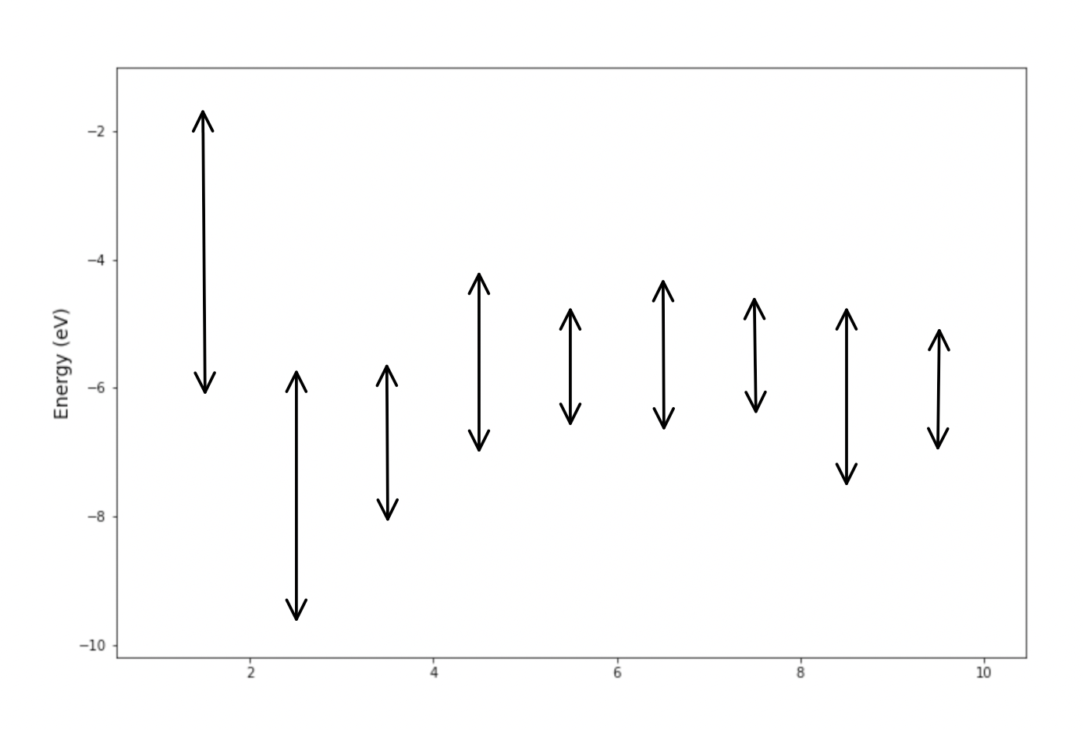
Ground-state electronic structure
Task1
Task 2
Task 3
2TN-TCNE
2.1
General observation:
HOMO mainly localized at donor and LUMO at acceptor
-NH₂ (EDG) cause shift to higher energy levels
-NO₂ (EWG) cause shift to lower energy levels
Smaller energy gap for -NH₂
TCNE has lower LUMO, larger energy gap compared to TCNQ
2T
2T-TCNE
2T-TCNQ
2TA-TCNE
2TA-TCNQ
2TN-TCNE
2TN-TCNQ
TCNE
TCNQ

Slide 7
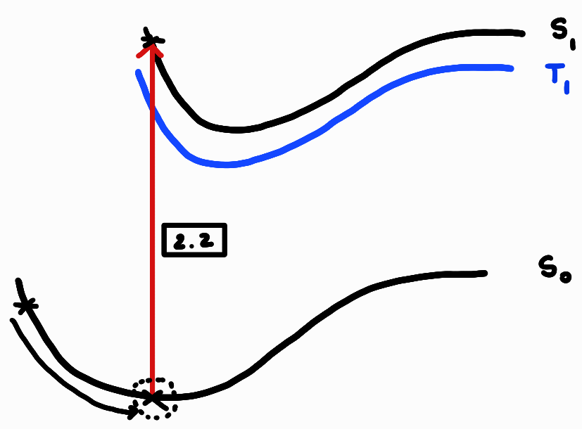
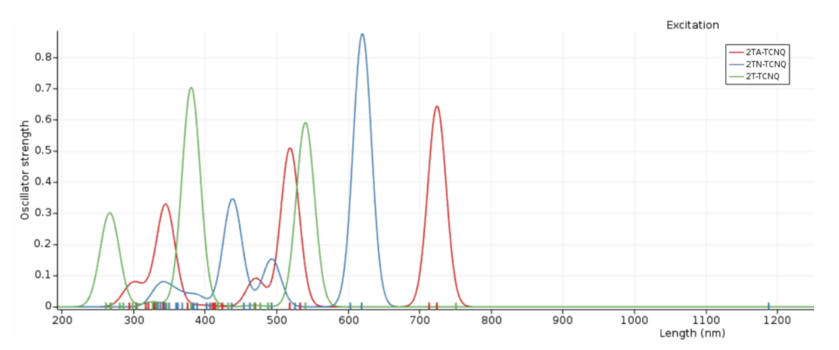
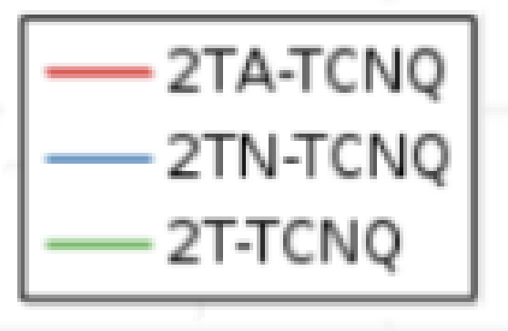
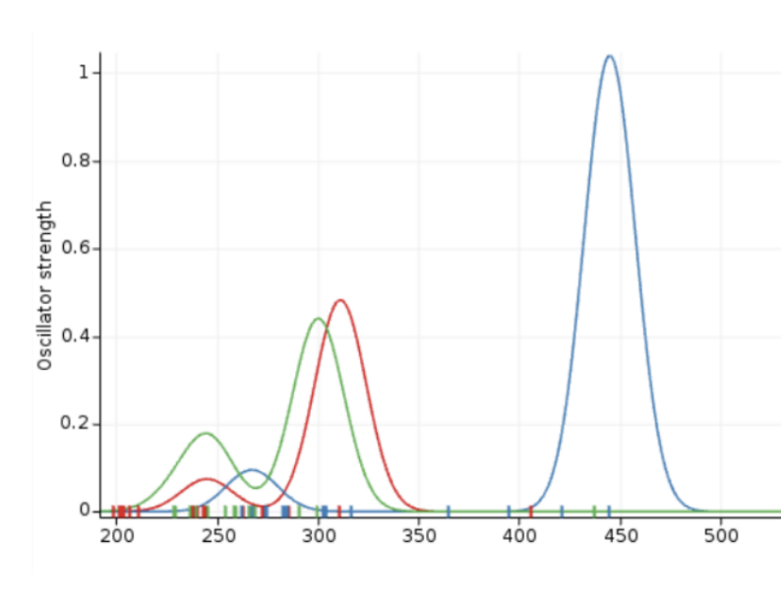

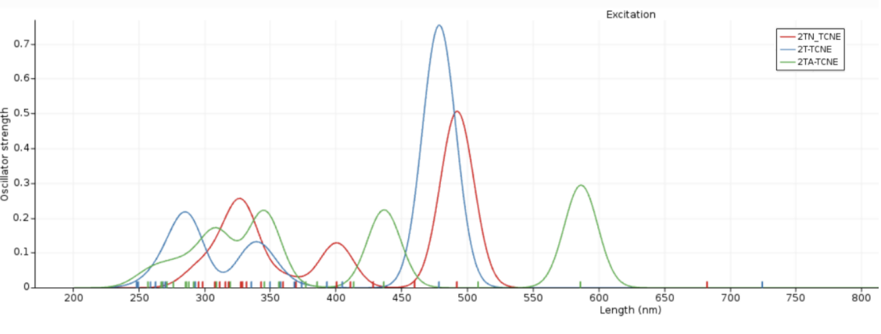
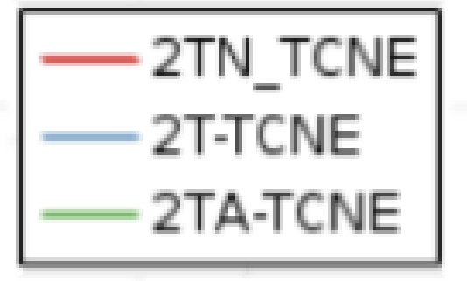
Absorption
Task1
Task 2
Task 3
2.2
TCNQ
TCNE
Lower energy peak better, can absorb all photons with higher energy: 2TA-TCNQ

Slide 8
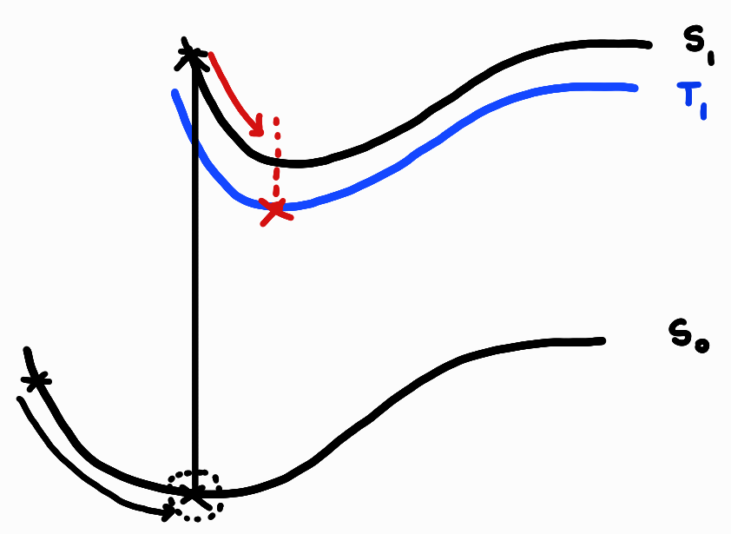
Excited-state geometry optimization & electronic structure
Task1
Task 2
Task 3
Excited-state geometry optimization
High complexity, for less computation time less accurate functional used (PBE)
No major geometric changes seen, although expected due to change in dipole moment after excitation
3.1
3.2

Slide 9
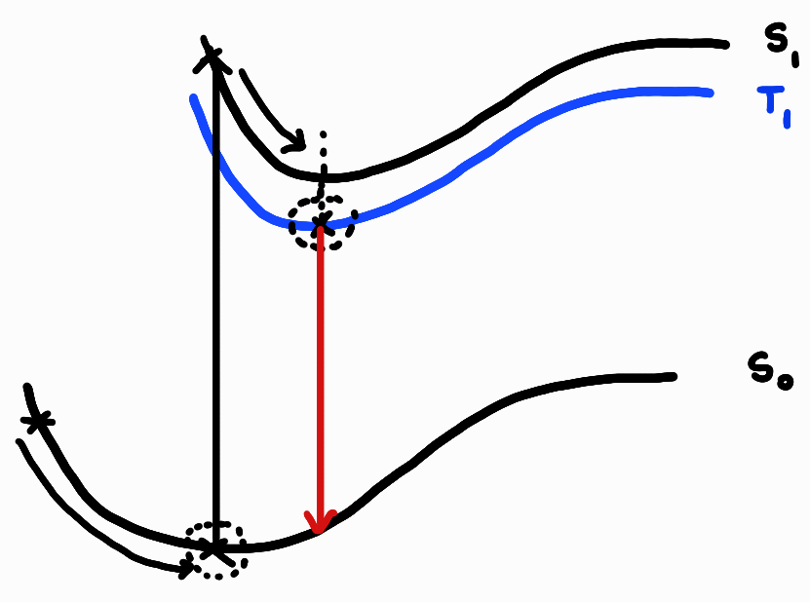
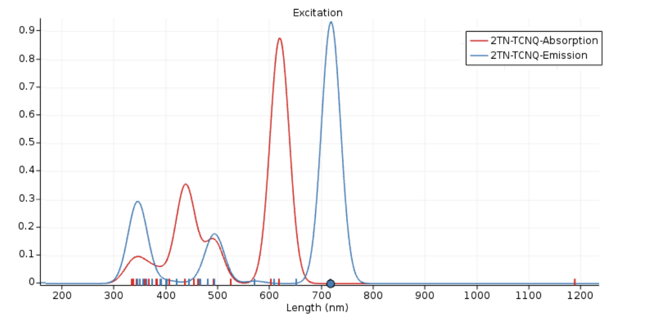

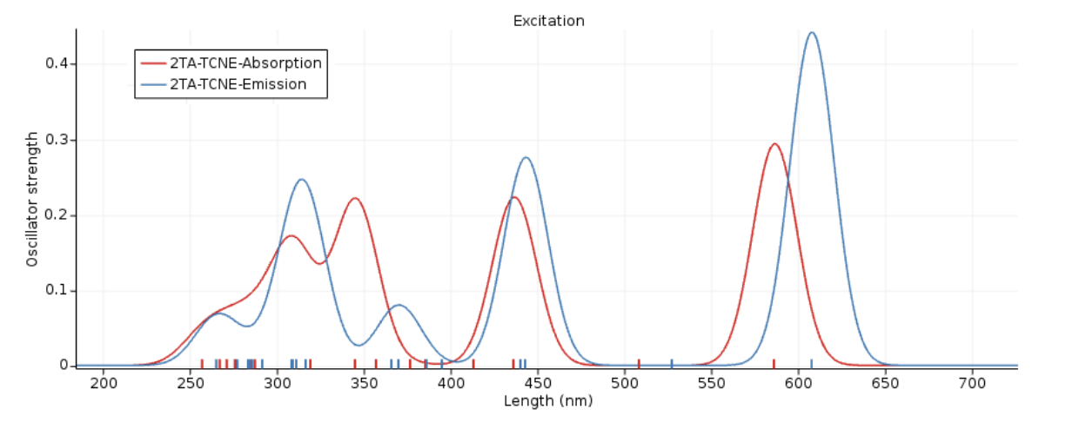
Task1
Task 2
Task 3
Excited-state emission
3.3
2TN- TCNQ least overlap
More losses due to vibrational relaxation
Larger stokes shift, more losses
2TA-TCNE has the greatest overlap
Transfer energy more easily via the Förster mechanism
Excitation diffusion without mass transfer

Slide 10
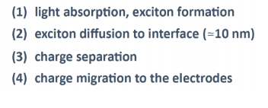
Förster energy transfer

Slide 11
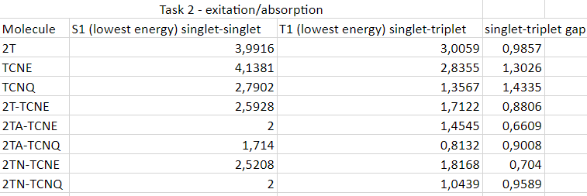

Conclusion
2TA-TCNQ best molecule in terms of absorption due to low energy peak of the molecule
Perhaps due to the fact that TCNQ itself has a low energy peak
2TA-TCNE best molecule in terms of least energy losses
Smallest gap between singlet-triplet energy
Higher absorption peak, light harvesting less efficient
Notes:
Absorption
- which photons are absorbed? - which molecule is the best? lowest absorption peak, because it can absorb all the photons with energy higher of that
Exciton diffusion
- förster mechanism
-which molecule is the best?
Energy loss in vibrational relaxation
-which molecule is the best?

Slide 12
Thank you!

